Slide 1
Indicators of Heart Disease
Samsung Innovation Campus
Artificial Intelligence

Slide 2


Our Team
Supervisor:
Prof. Doc. Doaa Mahmoud Abdelaty
Facilitator: Ziad Omar
Mahmoud Mohamed
Arwa Magdi
Mohamed Mady

Slide 3
Table of contents
01
04
02
05
03
06
Facts about Heart Disease
Buissines Solutions
Data Description
Modeling
Exploratory Data Analysis
Evaluation

Slide 4
01
Facts about Heart Disease

Slide 5
Facts about Heart Disease
One person dies every 34 seconds in the United States from Cardiovascular Disease.
About 697,000 people in the United States died from heart disease in 2020, that’s 1 in every 5 deaths (20%).
Coronary Artery Disease is the most common type of heart disease, killing 382,820 people in 2020.
Heart Attack, In the United States, someone has a heart attack every 40 seconds.
Total Coronavirus Deaths in the United States in 2020: 372,168.

Slide 6
02
Data Description

Slide 7
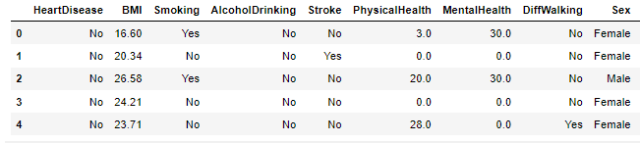
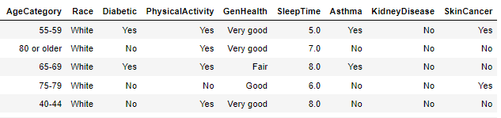
Data Description

Slide 8
03
Exploratory Data Analysis

Slide 9
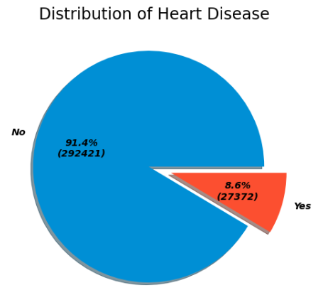
Heart Disease Distribution
So..
We found that only 8.6% of our population suffer from Heart Disease
Let’s explore more through our data..

Slide 10
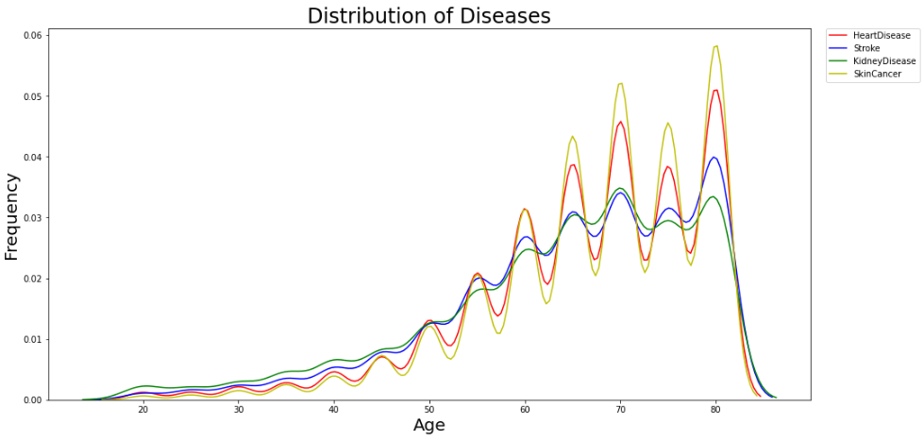
Distribution of Diseases through timeline
With the increase in age, the higher percentage of disease persons have.

Slide 11
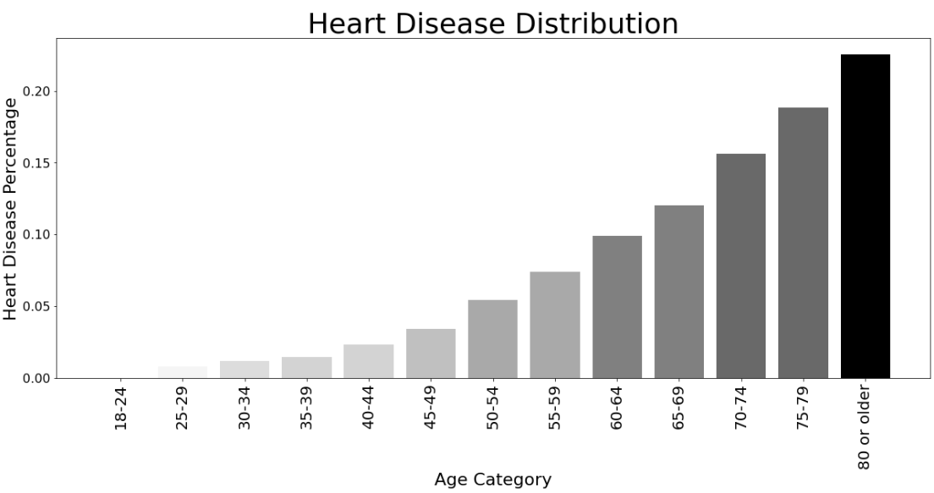
Distribution of Heart Disease Throughout the age categories

Slide 12
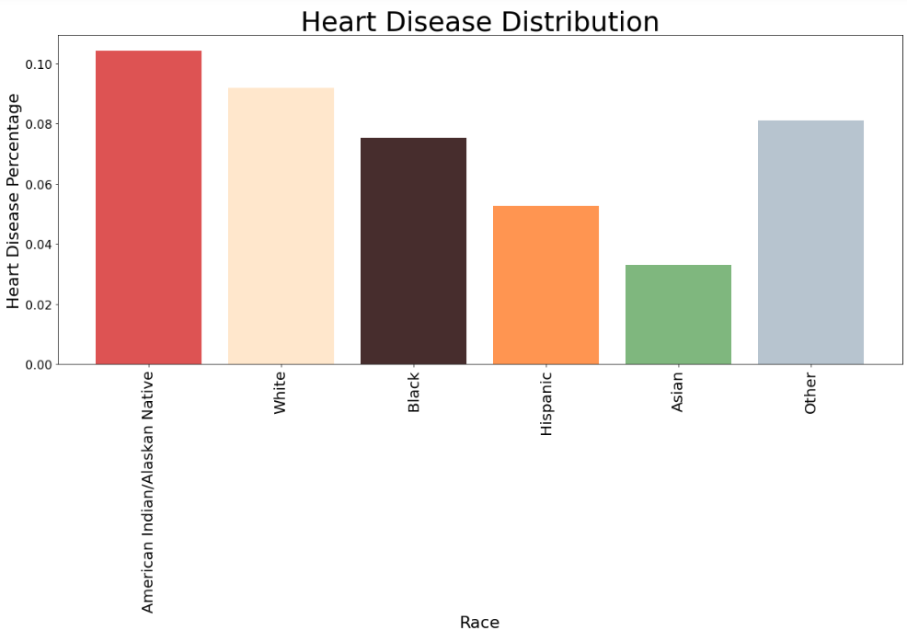
Distribution of Heart Disease
Here we noticed that the Asians are most likely not to suffer from Heart Diseases

Slide 13
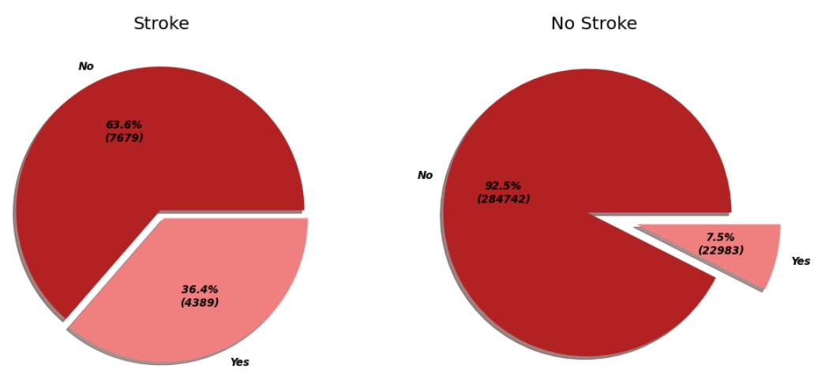
Distribution of Heart Disease Over people who had stroke
Stroke: occurs when the blood flow to the brain is suddenly interrupted or cut off. As a result, the brain is deprived of necessary oxygen and nutrients. The cells in the affected part of the brain then become damaged and the brain begins to die.
Notes:
Overall stroke percent

Slide 14
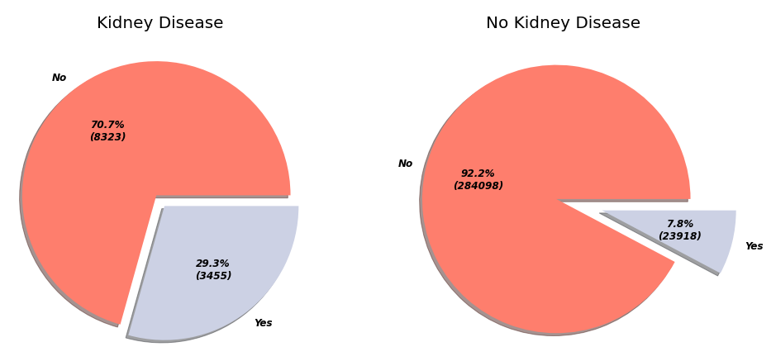
Overall, 3.6% of our population has Kidney Disease
Kidney disease means your kidneys are damaged and can't filter blood the way they should

Slide 15
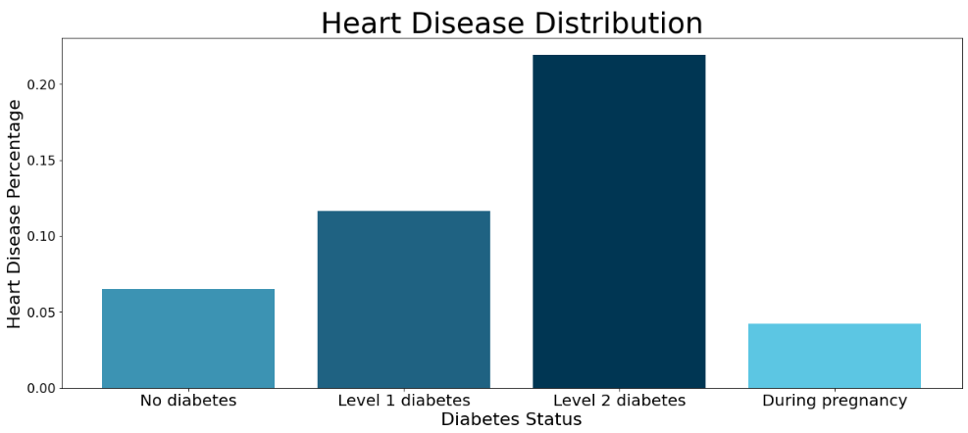
Distribution of Heart Disease
The higher diabetes level you have, the more chance you’ll get a Heart Disease

Slide 16
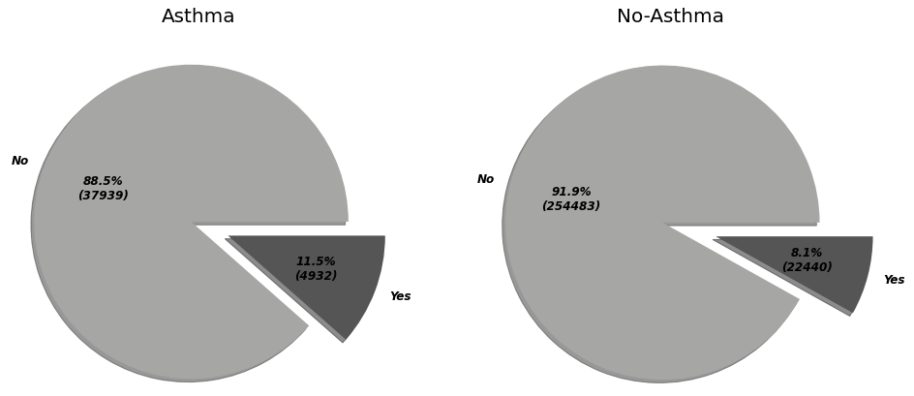
Distribution of Heart Disease
13% of our population have Asthma 11.5% of people who had Asthma before have Heart Disease

Slide 17
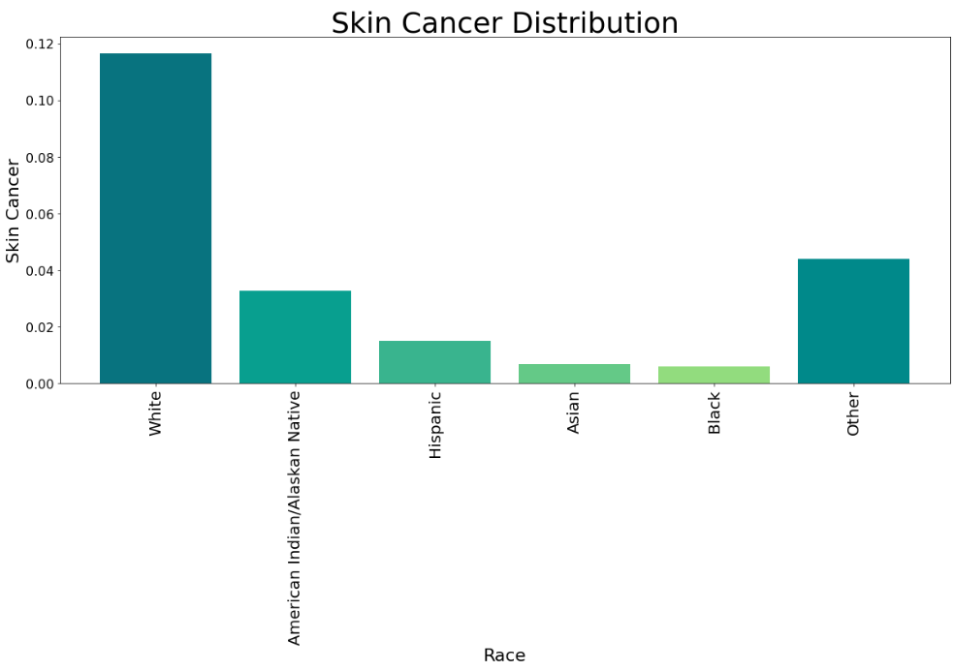
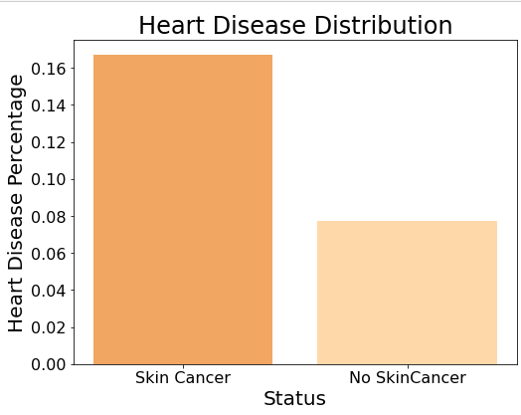
Distribution of Heart Disease

Slide 18
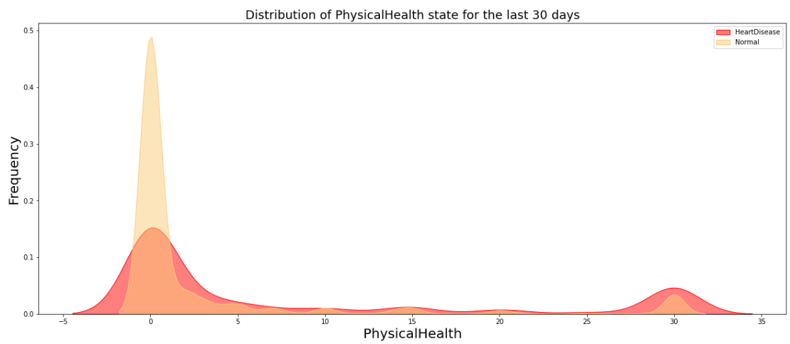
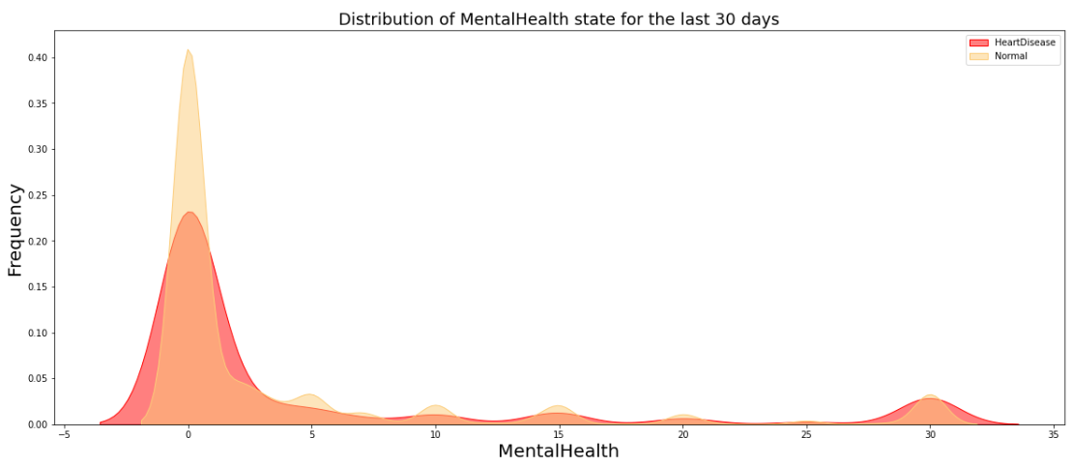
Heart Disease and its relation with both Physical and Mental Health
Physical Health status is more likely to increase the probability to get Heart Disease
Notes:
3 كلمات

Slide 19
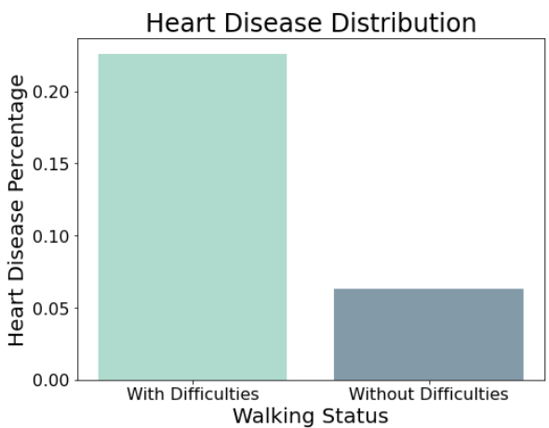
Heart Disease of course affects the ability to walk 13.8% of our Population has Difficulty in Walking 22.6% of people who have serious difficulties walking or climbing stairs have Heart Disease

Slide 20
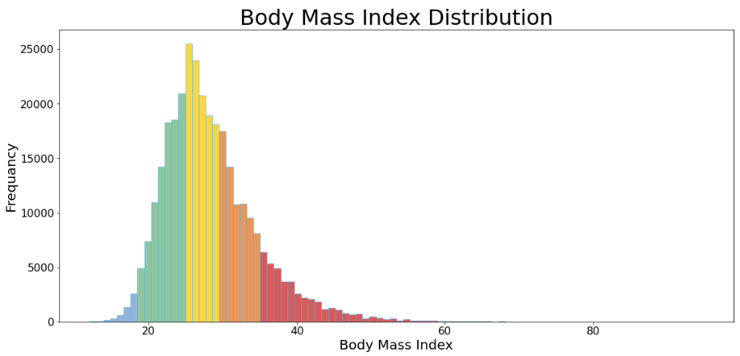
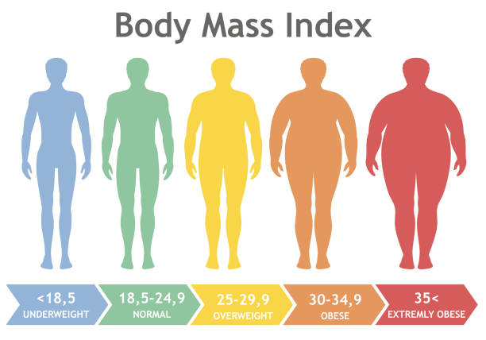
Body Mass Index Distribution in our population

Slide 21
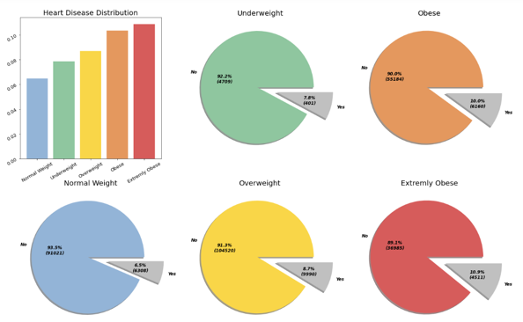
Distribution of Heart Disease over BMI Levels
The more the BMI increase, The more you are likely to suffer from Heart Disease
Notes:
كلمتين

Slide 22
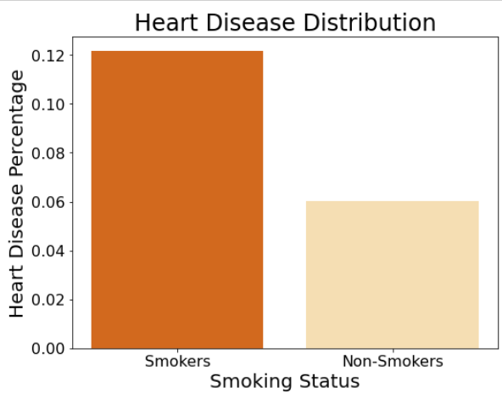
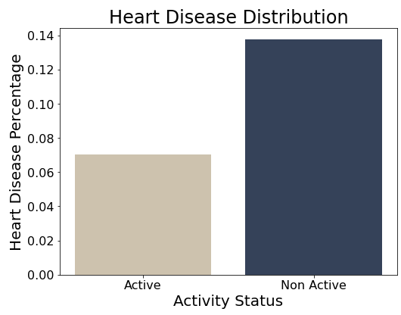
41% of our population are smokers 12.2% of them have Heart disease
Have you smoked at least 100 cigarettes in your entire life?
You should be really worried then...
Here we see that The physical activity has the same impact as Smoking on Heart Disease

Slide 23
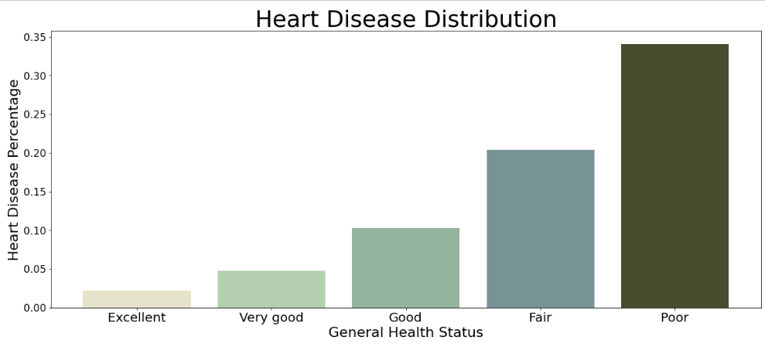
Most of the people who thought that their general health wasn’t good , were most likely to get Heart disease
So, Always trust your gut

Slide 24
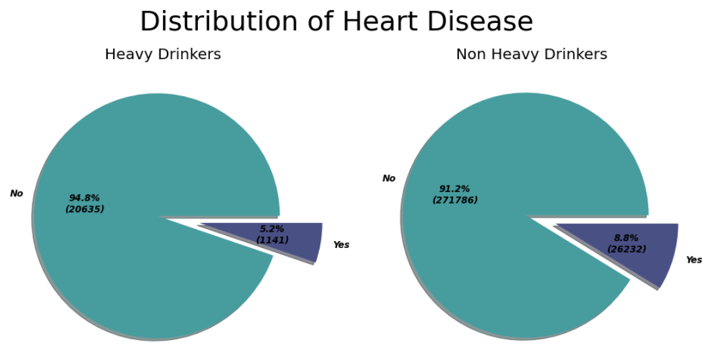
6% of Our population are Heavy Drinkers 5.2% of them have Heart Disease
Heavy drinkers are considered for adult men having more than 14 drinks per week and adult women having more than 7 drinks per week

Slide 25
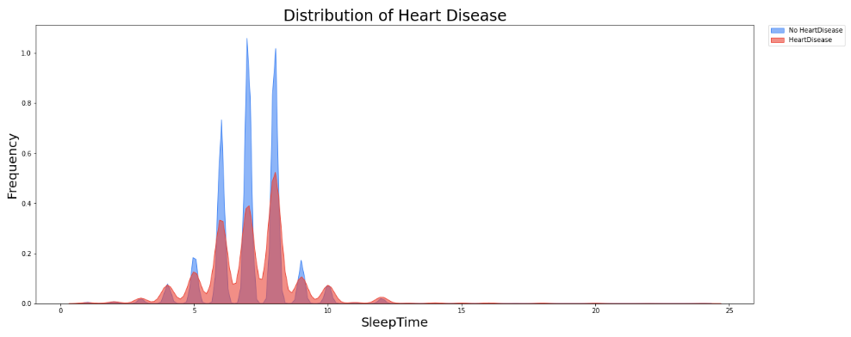
Distribution of Heart Disease
People who get less sleep are more likely to get Heart Disease

Slide 26
Business Solutions
00
01
02
Spread awareness between people to avoid some dangerous diseases
Check on certain patients with dangerous diseases rapidly
Advise certain patients to strictly stop smoking

Slide 27
Business Solutions
03
04
05
Try to be more active
Control your body mass index to be normal
Try to sleep enough hours daily

Slide 28
Models
Logistic Regression
K Nearest Neighbors
Support Vector Machine
Naïve Bayes
Decision Tree
Random Forest

Slide 29
06
Evaluation

Slide 30
This is a Table
 | Train Accuracy | Test Accuracy | F1 Score
KNN | 98.49 | 97.87 | 98
Logistic Regression | 91.58 | 91.57 | 92
Random Forest | 99.33 | 92.55 | 93

Slide 31
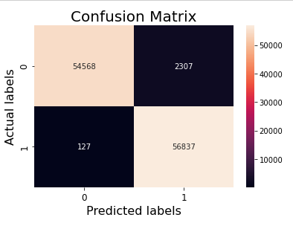
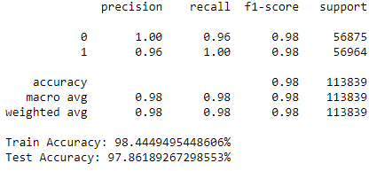

K Nearest Neighbors

Slide 32
Thank You !

